Slide 1

PLANNING NETWORK-BASED FIREWALL
Team members:
2010030046-e.pravallika
2010030168-Tahseen begum
2010030445-P.keerthana

Slide 2
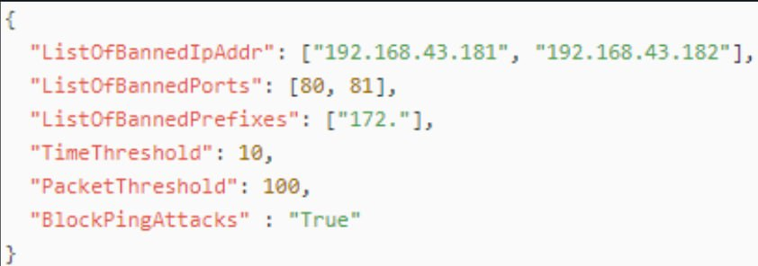
Code Explanation
from netfilterqueue import NetfilterQueue
from scapy.all import *
import time
import json
try:
f = open("firewallrules.json","r")
y = json.load(f)
f.close()
if("ListOfBannedIpAddr" in y):
if(type(y["ListOfBannedIpAddr"])==list):
ListOfBannedIpAddr = y["ListOfBannedIpAddr"]

Slide 3
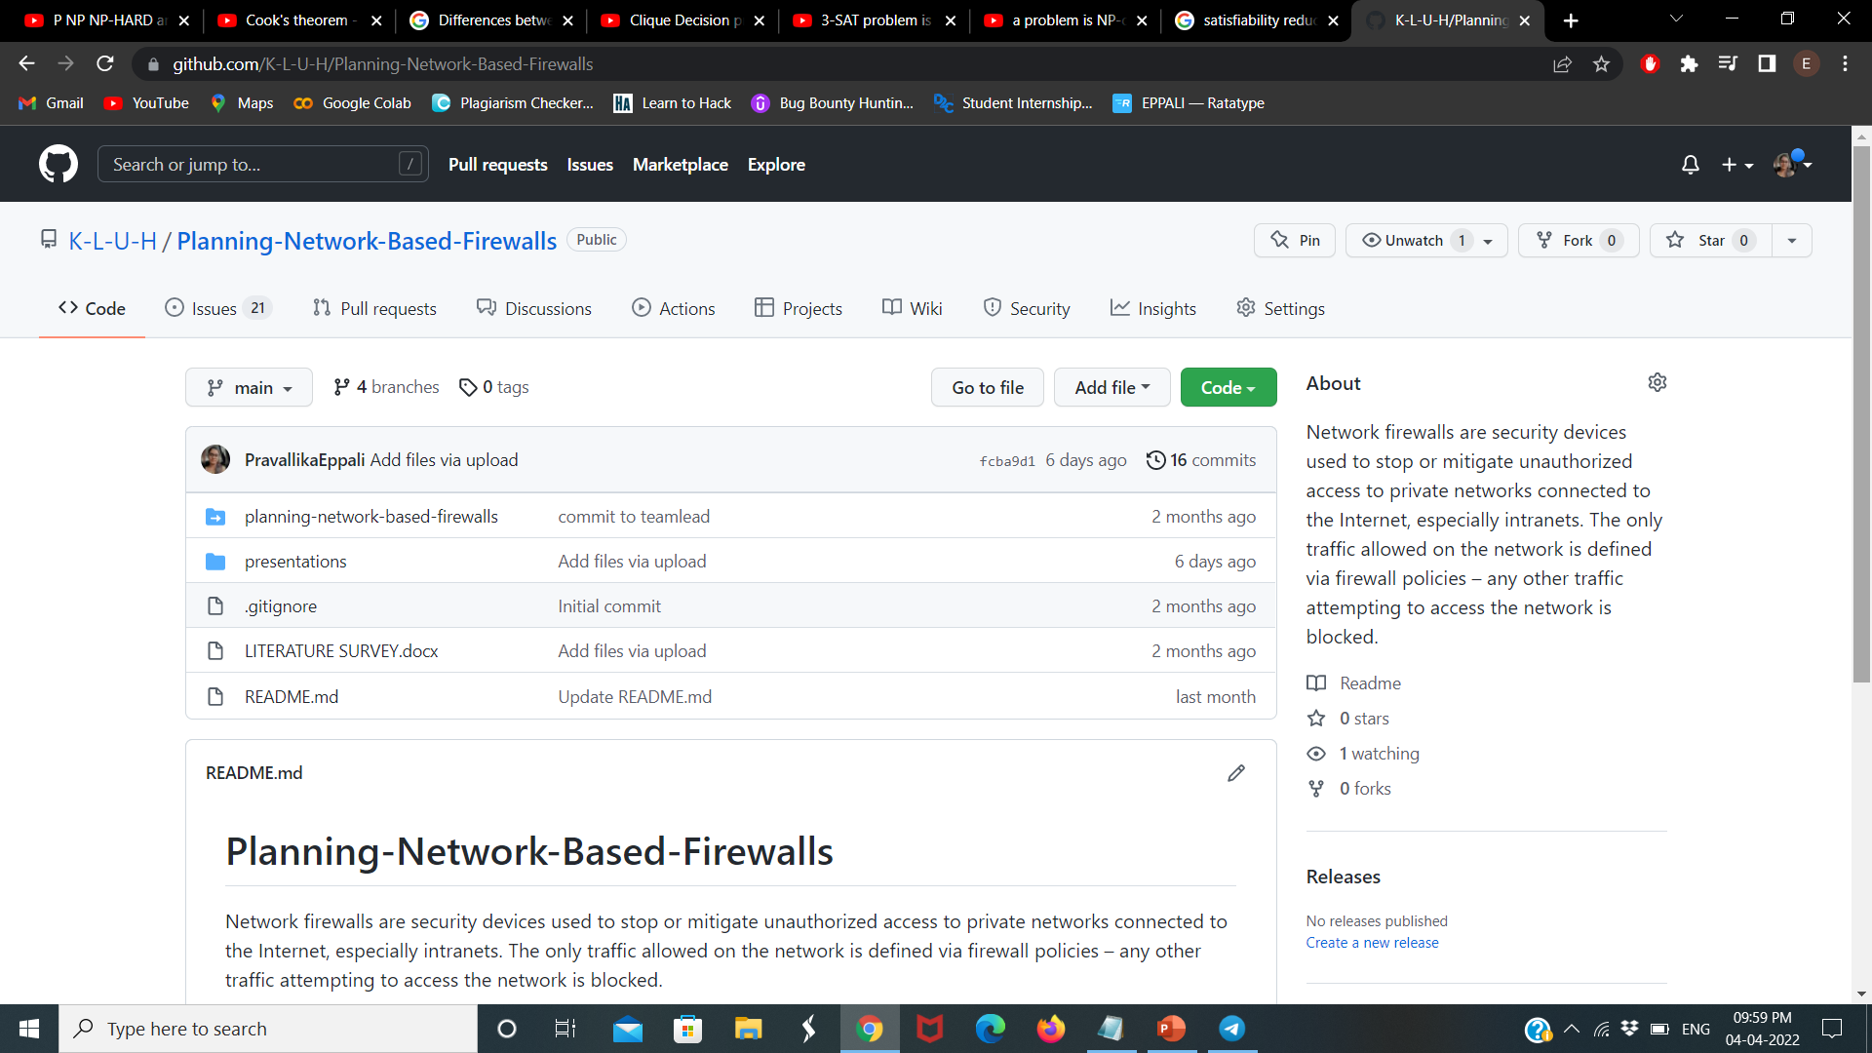
Github commits

Slide 4
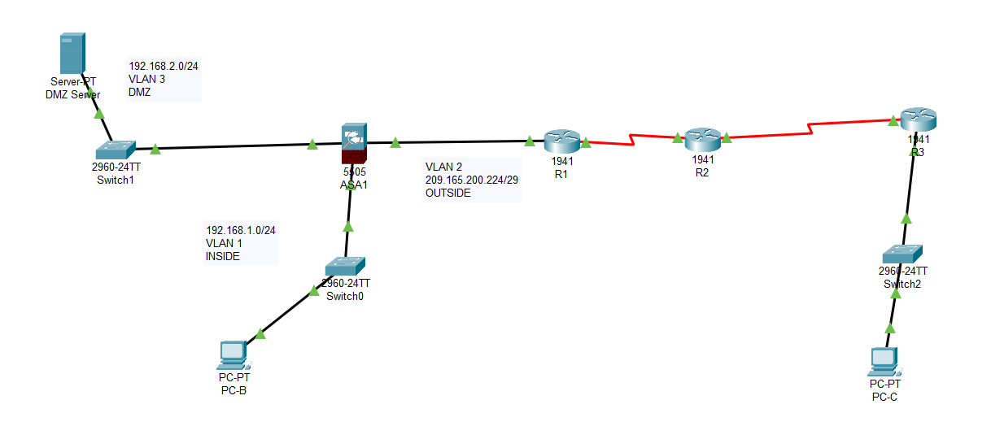
Work progress

Slide 5
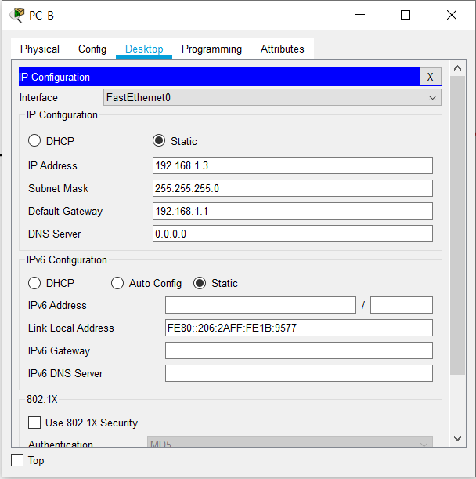
Beta testing

Slide 6
THANK YOU

